Slide 1
Office 365 Development
July 2014

Slide 2
Course Agenda
Introduction to Office 365 Development
Module 1: Deep Dive Apps for Office in Outlook
Module 2: Deep Dive Apps for Office in Word
Module 3: Deep Dive Apps for Office in PowerPoint
Module 4: Deep Dive Apps for Office in Excel
Module 5: Deep Dive into SharePoint Hosted Apps
Module 6: Deep Dive into Provider Hosted Apps
Module 7: Deep Dive into Security and OAuth
Module 8: App Lifecycle Management

Slide 3
Deep Dive into SharePoint-Hosted Apps
Speaker
Speaker

Slide 4

Agenda
Introduction to Apps for Excel
Developing Apps for Excel
Reading and Writing with Documents
Document Bindings

Slide 5
What is an App for Office?
A Web page loaded inside an Office Application
Embedded inline or as task pane within documents, mails or appointments.
Works in both Office Applications and Office Web Applications
Office application extensions using Web technologies
HTML 5 and CSS used to construct user interface
JavaScript and jQuery used to add executable logic and event handlers
App can provided code to read/write content to/from Office documents
App can call Web services hosted over Internet or running within local network
Notes:
An App for Office can be seen as a Web page loaded inside an Office Application. In some cases it will appear embedded inline within the document. In other cases it might appear as a task pane or within a message in Outlook. Note that the architecture for Apps for Office has been designed to work in both Office Applications and Office Web Applications.
WEF and Apps for Office allow Office applications to be extended in such as way so that they can leverage Web technologies such as HTML 5 and CSS for rendering user interface as well as JavaScript and jQuery to add behavior. When you write the JavaScript code for an App for Office, you can call REST APIs such as those added to SharePoint 2013 to retrieve and update data from across network.

Slide 6
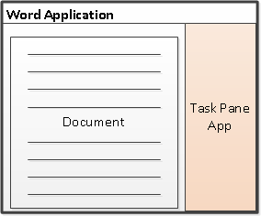
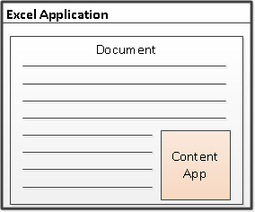
Shapes for Document-based Apps
Task Pane App
Positioned to right of document
Used to assist user working with document
Can search and retrieve content from Internet
Content App
Adds content inline into position within document
Document is always an Excel workbook
Content app can read and write document contents
Notes:
There are two basic styles (i.e. shapes) for creating an app for Office.
A task pane app is positioned to right of document in a style that is familiar to experience Officers users. A task pane app is typically used to assist a user working with a specific document. For example, a task pane app can be designed to search and retrieve content from Internet that can be inserted into the document.
A content app is designed to add its content inline into a position within current document. Note that content apps are only supported into Excel so that document is always an Excel workbook. The content app must be added to a specific worksheet within a workbook. The content app can read and write contents to cells within the same workbook.

Slide 7
App for Office Runtime Environment
Web Extensibility Framework (WEF)
Allows Web page content to render inside Office Application
Allows Web page code to run within a set of constraints
Allows Web page code to interact with Office documents
Allows Web page code to interact with Exchange items
WEF provides runtime environment for Apps for Office
Apps for Office provide basis for a component architecture
Apps for Office provide ability to publish to App Catalogs and/or Office Store
Apps for Office can be deployed in private networks
Notes:
The Web Extensibility Framework (WEF) is a new development platform used to extend Office applications. This platform allows Web page content to render inside Office Application and to interact with Office documents such as Word document and Excel workbooks and Exchange items such as messages and appointments.
The WEF development platform is used to develop Apps for Office. Apps for Office provide basis for a component architecture which allows developers to build apps which target Office application and Office Web applications such as Excel services and Outlook Web Access.
WEF and the Apps for Office development model provide foundation for distribution of apps using an app directory such as the Office Store and the App Corporate Catalog used to deploy apps in private networks.
Throughout the beta cycle of Office 2013, Apps for Office have been given a codename of "Agave". Note that this codename is only intended for the beta cycle and will disappear by RTM when they will just be called "Apps for Office" or a variation thereof.

Slide 8
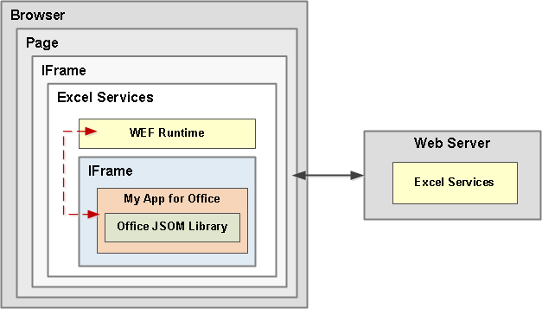
Apps for Office running in Excel Services
Browser-rendered Apps based on Web standards
Works across all popular browsers (might require the latest version)
App runs its it own iFrame inside outer an iFrame with WEF runtime
Communications between iFrames relies on HTML5 postMessage API
Notes:
For Office 2013 Web Apps, WEF components are hosted inside an IFrame. WEF component support is enabled in the Web Apps by the integration of the Office JavaScript library that, in a similar fashion to the rich client applications, manages of the WEF component lifecycle and interoperability between the WEF component and the Web App, which for the browser requires a special cross-frame communication infrastructure. The same Office JavaScript library used on rich clients supports the APIs available to the WEF component code to interact with the Web App.

Slide 9




Anatomy of an App for Office
Each App for Office is based on XML-based manifest
Manifest points to a Web page
Manifest defines the type of the App for Office
Manifest defines which Office applications it supports
Manifest defines required capabilities
App for Office
Catalog Server
Web Server
App for Office
App for Office
Manifest
<XML>
Web
Page
HTML+JS
Notes:
Every App for Office must be distributed with an XML-based manifest which contains information about the app itself. For example, the app manifest contains an address to a Web page on the Internet which is used to load the app. The app manifest also includes information which indicates which Office applications it supports. The app manifest also defines the required capabilities which represent the set of permissions that the app needs in order to run and complete its work.

Slide 10
Developing Apps for Excel

Slide 11
Visual Studio Experience
Create new App for Office project
Create/design user interface for Web page
Enhance Web page with CSS and JavaScript
Set project properties in manifest
Run!
Notes:
This slide is pretty self-explanatory and demonstrates just how easy it is to create and test your first App for Office using Visual Studio 2012. First, you will create a new project using one of the new project templates in Visual Studio 2012. Next, you will create the user interface for the app using HTML5 and CSS. After that, you add behavior to the app by writing JavaScript. Finally, you will update the XML file which serves as the app manifest. After that, you can press the {F5} key to test and debug your app.

Slide 12
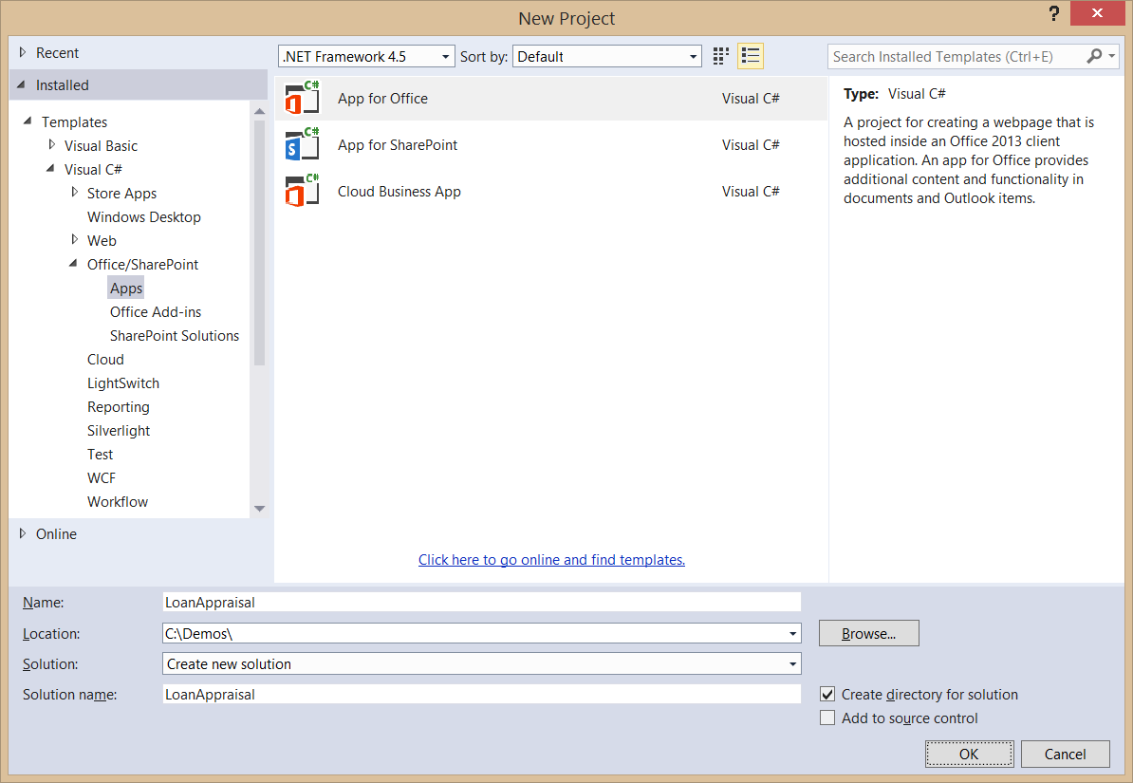
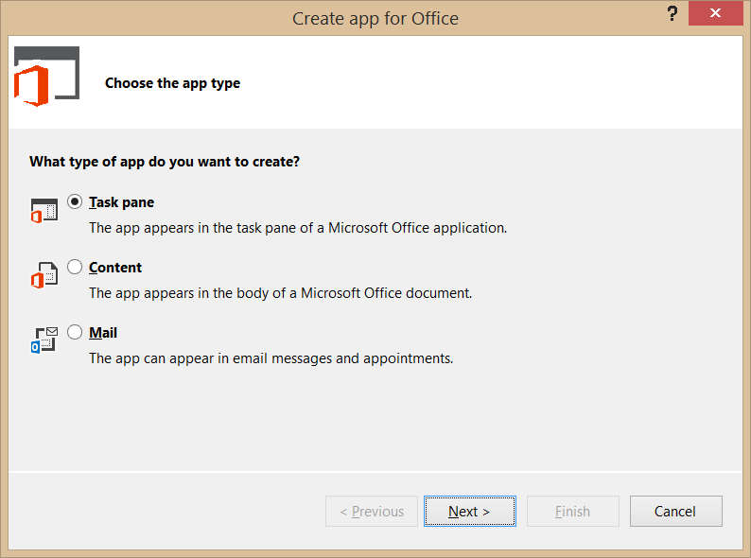
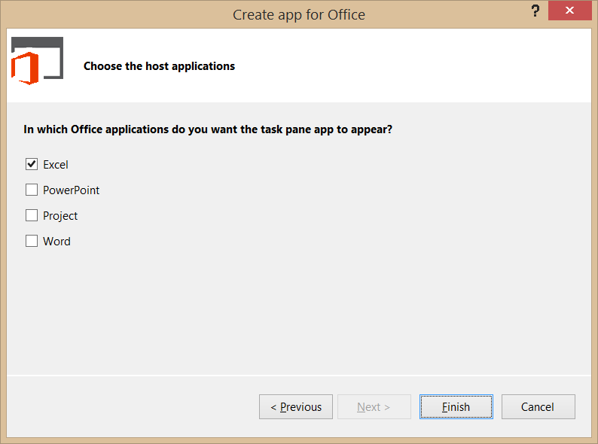
Create New App for Office Project
Create project based on App for Office 2013 project template
Dialogs appear and prompts you for specifics about the app
You must choose (1) the app shape and (2) which Office application are to be supported
Notes:
Visual Studio has a new project template for Apps for Office. These project types gives you a starter project with a web page and manifest.

Slide 13
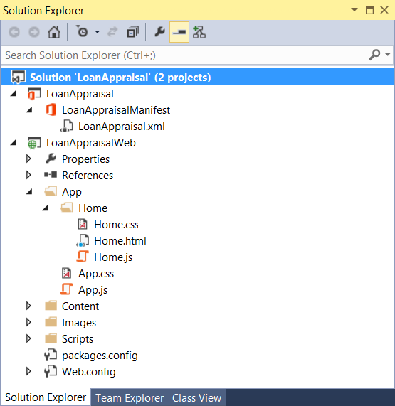
App for Office Project Structure
App for Office solution has two projects
Top project contains app manifest
Bottom project for remote web
Remote Web Project is ASP.NET Website
Contains HTML, CSS and JavaScript source files
Integration with jQuery library already included
Notes:
The slide shows the initial structure of a task pane app created with the Visual Studio 2012.

Slide 14
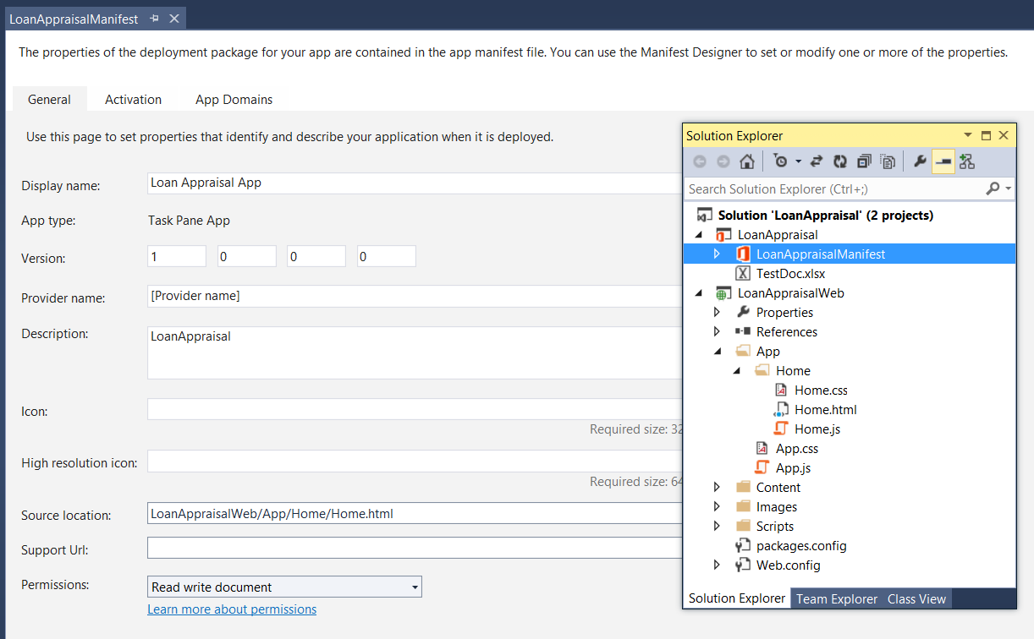
App Manifest Designer
Notes:
This slide shows the Visual Studio designer for an app manifest in a task pane app. It will look different for other types of Apps for Office.

Slide 15
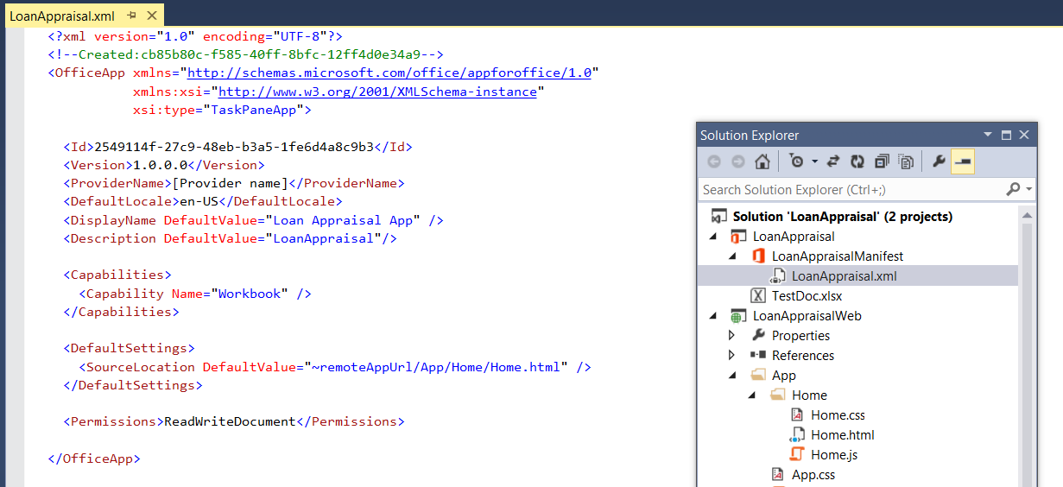
App Manifest - XML View
Notes:
There are times when it is also useful or necessary to examine or update the manifest in XML view. You can enter XML view by clicking the XML file in the Solution Explorer.

Slide 16
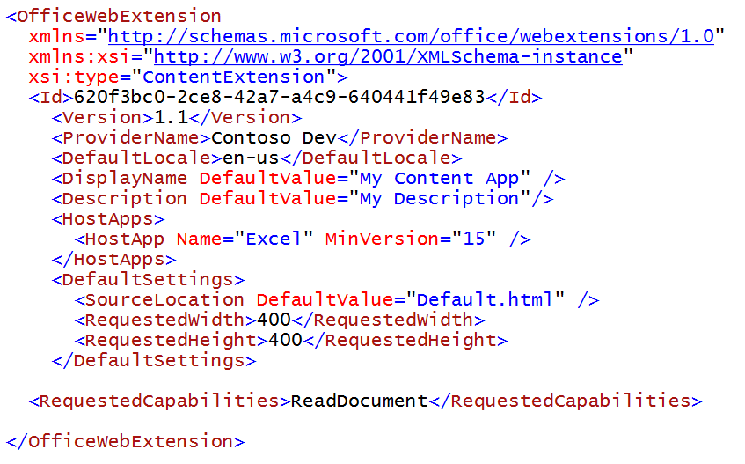
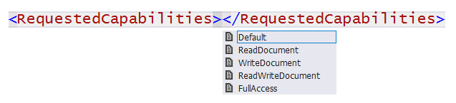
Requested Capabilities
Default (restricted)
You can read/write document settings
ReadDocument
You have read access to document
You can subscribe to change events
WriteDocument
Write content into document
ReadWriteDocument
ReadDocument + WriteDocument
FullAccess
All Permissions + use of Silverlight & Flash
Notes:
The last things to think about is how much permission an app need to completed its work. You should try and limit the requested permissions to the absolute minimum. It is a design mistake to request more permissions than you app actually needs. Here is a breakdown of the available permission levels you can request in the RequestedCapabiliites element inside the app manifest.
Default (restricted) allows you to read and write document settings but provides no access to the content within the document itself.
ReadDocument allows read access to document as well as read/write access to document settings and the ability to create bindings and register for document level events
WriteDocument allows write access to document at the current selection as well as read/write access to document settings. However the app cannot read any contents of the document itself.
ReadWriteDocument provides the combined permissions of ReadDocument and WriteDocument together
FullAccess provides all permissions of ReadWriteDocument plus the right to use other Web technologies such as Silverlight or Flash within the app.

Slide 17
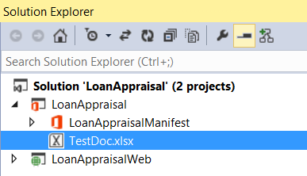
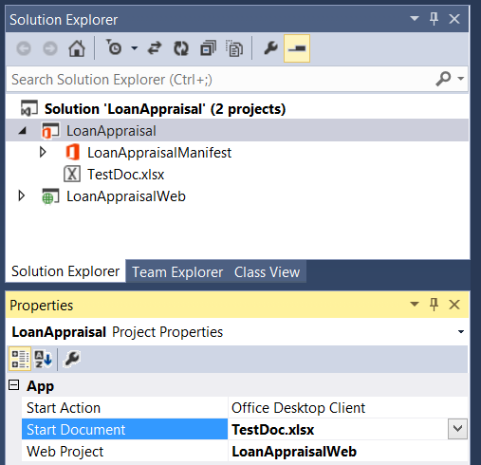
Adding a Test Document for Debugging
Steps to add a test document
Add document file to app project
Configure Start Document project property
1
2

Slide 18




A common API for document-based Apps
Document-based Apps for Office have common objects
Used to read and write content to and from document
Used to create bindings and event handlers
Common Objects x-Office!
Picture
Charts
Clip Art
Hyperlink
Text
Table
Matrix
XML Parts
Word Art
Shapes
Notes:
Office 2013 provides a common JavaScript API for developing document-based apps. This API provides a common set of objects used to read and write content to and from document. The common API can also be used to create bindings and event handlers. Note that with Office 2013, the common API is only used across Word and Excel but there are plans to expand the common API and have it used by additional Office applications in later versions.

Slide 19
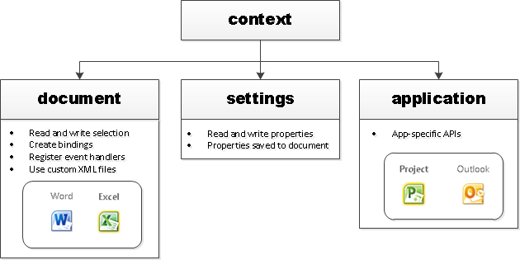
Core API Objects
Office.context
Entry point into Office API
Office.context.document
Common document API
Office.context.settings
Custom properties saved within document
Office.context.application
App-specific APIs (e.g. Project JSOM)
Notes:
The Office JavaScript object model provides a top-level object named Office with a context property which provides your entry point into the API. The context property provides three properties which expose the following objects.
Office.context.document provides access to the current document.
Office.context.settings provides access to a custom property bag allowing the developer to save and retrieve custom property settings
Office.context.application provides access to the entry points for app-specific APIs such as the APIs used to program against Microsoft Project and Outlook

Slide 20
demo
Creating an App For Office Targeting Excel

Slide 21
Reading and Writing with Documents

Slide 22
Interacting With Document Content
All data access starts through document object
Read/write access to user selection
Event handler for selection change event
Three data types are supported
Text
Matrix
Table
Notes:
All data access with word documents and excel workbooks starts through the Office.context.document object. It provides functions to read content from a document and to write content to a document based on the current selection. The document object also provides the means to wire up event handlers to fire when the user changes the current selection.
There are three primary data types that are supported when reading and writing data.
Text is a data type that represents a simple text value.
Matrix is a data type that supports a static 2D array of rows and columns.
Table is a data type that supports a dynamic 2D array with named columns and a set of rows where rows and be added and deleted.

Slide 23
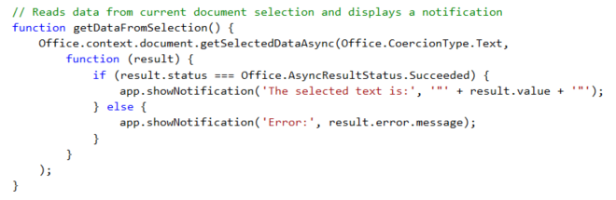
getSelectedDataAsync()
Use this function to read from document select
Notes:
The function getSelectedDataAsync is used to read content from the selected region of the current Word document.

Slide 24

Setting Selected Data
setSelectedDataAsync (data, {coercionType, asyncContext}, callback)
Use asyncResult parameter in callback function to verify call was successful
Passing data to setSelectedDataAsync
For text shape, pass data as string
For matrix shape, pass data using 2 dimensional JavaScript array
For table shape, pass data using TableData object
Coercion types can be used to convert string to/from HTML and OOXML
Dealing with table size when inserting data
If single cell selected: table of any size can be written
If range selected range, supplied array must match size of table being written
Notes:
You should use the document's setSelectedDataAsync method to write content back to a document. When calling the setSelectedDataAsync function, you will pass a callback function and use the asyncResult parameter in this callback function to verify call was successful
You must determine how to pass data when calling setSelectedDataAsync. For text shape, you can pass data as a string. For matrix shape, you should pass the data using 2 dimensional JavaScript array. For a table shape, you should pass the data using a special TableData object which can be created using the Office JavaScript API. Also note that with Word you can also use two additional coercion types which are HTML and OOXML.
There are a few tricks you should know about when dealing with matrix and table size when inserting data. If the user has selected a single cell selected, a matrix or table of any size can be written. However, if the user has select a range with two or more cells, the matrix or table be written must match the size of target range exactly with respect to the number of rows and columns.

Slide 25
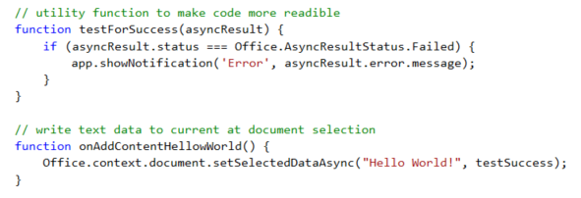
setSelectDataAsync()
Use this function to insert content into document
Notes:
The function setSelectedDataAsync is used to write content into the selected region of the current document. If there is no selected region, the content is added at the location of the cursor.

Slide 26
Coercion Types
Content in binding/selection can be converted on read/write
Text
Matrix
Table
HTML
Office Open XML (OOXML)
Office.context.document.getSelectedDataAsync(‘ooxml’, etc…)
Notes:
There are five possible coercion types. In some cases, it should be obvious whether to use Text, Matric or Table. Note that HTML and OOXML are advanced coercion types that are only support in Word 2013 and not in Excel.

Slide 27
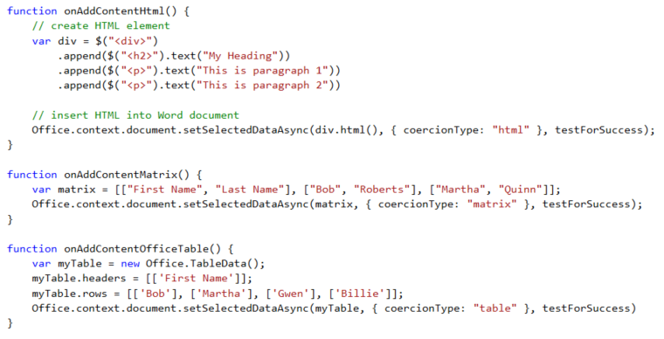
Coercion Types
Coercion types make it possible to read/write content in different formats
text - string value
html - HTML content
matrix - array of arrays
table - table of rows and columns
ooxml - Office Open XML format

Slide 28
demo
Reading and Writing Document Content

Slide 29
Document Bindings

Slide 30
What are App Bindings?
Bindings link an App for Office to a specific document section
Can be defined current selection of a named item in a template
Arbitrarily read/write binding data at anytime
R/W operations do not depend on a selection.
Enable Event handling
Bindings support three different data shapes
Text binding for binding to an individual cell in Excel or text in word.
Matrix binding for a two dimension array representing rows and columns
Table binding is like a matrix binding with support for headers
Notes:
Bindings are a valuable concept because they link an app to a specific section within a document. A binding can be created based on the current selection. A binding can also be defined used a named item such as a named range in an Excel workbook or a bookmark in a Word document. A binding adds value by providing a named section that can be read from or written to regardless of what the current selection is. A binding also support events so you can add an event handler that detects when the user has made a change to the content inside a binding.
Bindings support three different data shapes. Text bindings are used for binding to an individual cell in Excel or text in word. Matrix bindings are used for a two dimension array representing rows and columns. Table bindings are used to support Excel tables with named columns and a set of rows that support inserts and deletions by the user.

Slide 31
Bindings in App for Office with Excel
Excel supports data binding to content in document
Excel supports binding to named ranges inside Workbook
Bindings created using name of named range which serves as ID
You can read and write bound content regardless of where selected region is
You can register event handlers to fire when user updates bound content
Notes:
Bindings are import because they make it so you can read and write to specific areas in a Word document without having to worry about what the selected region is

Slide 32
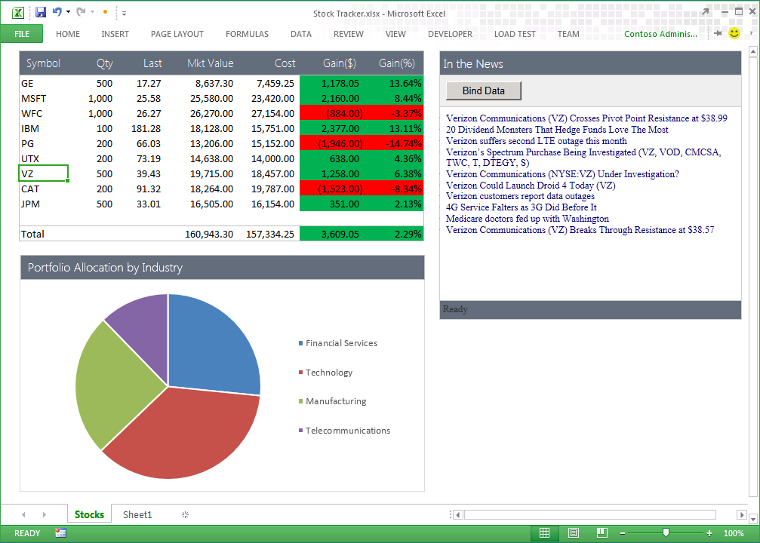
Uses of Apps for Office Bindings
App handles SelectionChanged event associated with the binding to retrieve news associated with stock symbol
Bound range of stock symbols
Notes:
Bindings provide a scope which allows an app to distinguish between selection changes or updates at the document level or just within a specific section of a document. Therefore, bindings can bridge the gap between Office documents and the cloud. Bindings are also key in reading and writing data and detecting changes made by the user.

Slide 33
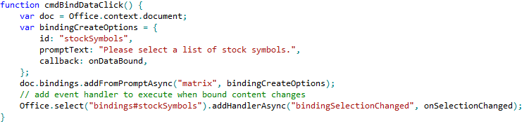
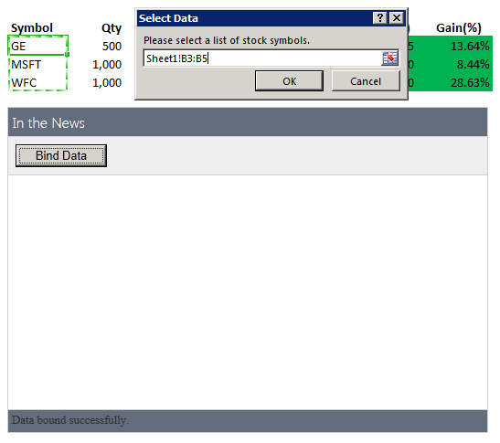
Using Bindings
Adding a binding
Bindings.addFromPromptAsync
Bindings.addFromSelectionAsync
Bindings.addFromNamedItem
Referencing a binding
Bindings.getAllAsync
Bindings.getByIdAsync
Office.Select
Removing a binding
Bindings.releaseByIdAsync
Binding event handler to a binding
Binding.addHandlerAsync(“type”, handler);
A dialog is presented to the user experience when you call addFromPromptAsync.
Notes:
To add a binding, you should use one of the following method
Bindings.addFromPromptAsync
Bindings.addFromSelectionAsync
Bindings.addFromNamedItem
You will also need to reference bindings to read and write content and register event handlers. When you need to reference a binding, you can use one of these method.
Bindings.getAllAsync
Bindings.getByIdAsync
Office.Select
If you ever need to remove a binding, you can use this methods.
Bindings.releaseByIdAsync
To register an event handler on a binding, you can use the following method.
Binding.addHandlerAsync(“type”, handler);

Slide 34
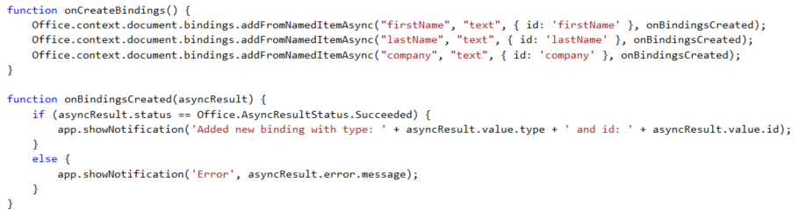

Adding Bindings in JavaScript
Notes:
The top code listing shows how to create bindings in JavaScript code using addFromNamedItemAsync. Note that the first parameter (e.g. "firstName") is used to indicate which content control you want to bind to. The third argument (e.g. { id: 'firstName' } is used to create the binding ID that will be used to retrieve the binding when call the Office.select function.
Note that the call to Office.select gets the binding using a syntax of "bindings#" followed by the ID of a registered binding.

Slide 35
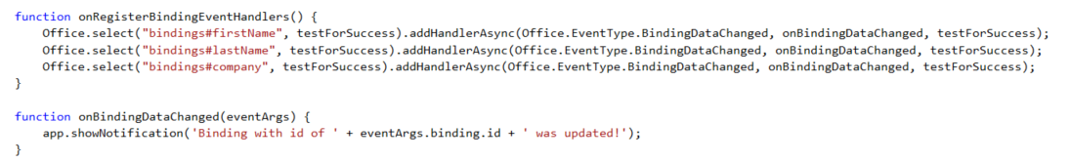
Adding Event Hander Bindings
Event handlers added using addHandlerAsync
Callback function called automatically when user updates binding content
Notes:
This code shows how to register an event handler on a binding using the addHandlerAsync function.
The call also registers a callback function named onBindingDataChanged which is called automatically when user updates the bound content.

Slide 36
demo
Creating an App using Bindings and Event Handlers

Slide 37
Summary
Introduction to Apps for Excel
Developing Apps for Excel
Reading and Writing with Documents
Document Bindings

Slide 38

© 2012 Microsoft Corporation. All rights reserved. Microsoft, Windows, and other product names are or may be registered trademarks and/or trademarks in the U.S. and/or other countries.
The information herein is for informational purposes only and represents the current view of Microsoft Corporation as of the date of this presentation. Because Microsoft must respond to changing market conditions, it should not be interpreted to be a commitment on the part of Microsoft, and Microsoft cannot guarantee the accuracy of any information provided after the date of this presentation. MICROSOFT MAKES NO WARRANTIES, EXPRESS, IMPLIED OR STATUTORY, AS TO THE INFORMATION IN THIS PRESENTATION.

